Slide 1

Credit Risk Analysis -EDA
Team#8:
P.Swathi priyadarsini
Deepraj vadhwane
Prajwal Gharal

Slide 2
Objectives of Credit risk analysis:
Credit risk Assessment
To reject the loan
Reduce the loan amount
Increase the Interest rate
Work Flow:
Loading the data set
Detect Target variable
Data cleaning
Univariate Analysis
Bi-Variate Analysis
Visualization
Conclusions

Slide 3
Details of the data set
Data Cleaning:
Feature — 1 — -> Age (in years)
Feature — 2 — -> Annual Income (In INR)
Feature — 3 — -> Home ownership (Nominal Categorical)
Feature — 4 — -> Employment length (in years) (895 Null values )
Feature — 5 — -> Loan intention (Purpose of Loan)
Feature — 6 — -> Loan grade (Ordinal Categorical)
Feature — 7 — -> Loan amount (in INR)
Feature — 8 — -> Interest rate (in percentage) (3116 Null Values)
Feature — 9 — -> Loan status (Categorical) – Target Variable
Feature — 10 — -> Loan — Percent income (Debt — Equity Ratio) (in percentage)
Feature — 11 — -> History of default (Nominal Categorical)
Feature — 12 — -> Credit history length (in years)
** 165 Duplicates have been dropped
Original Data set
(32581,12)
After removing Null values and duplicates (28501,12)
Outliers are treated using Median Imputation Method

Slide 4
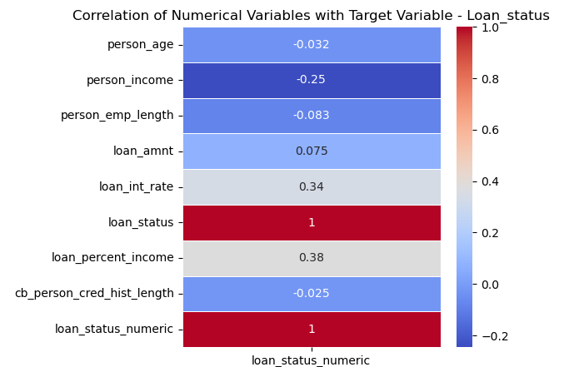
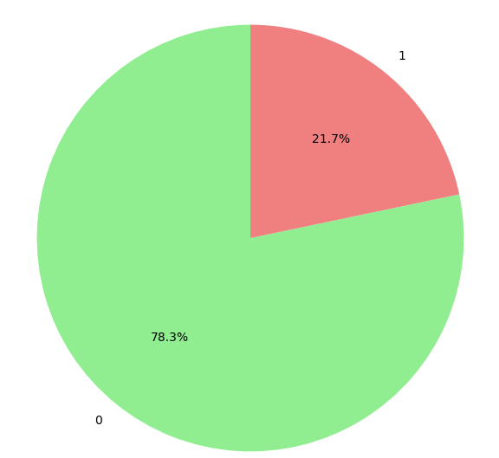
Target Variable:
Distribution of Target Variable
Loan status
’’Non-Default – 0’’
Loan status –’’Default – 0’’

Slide 5
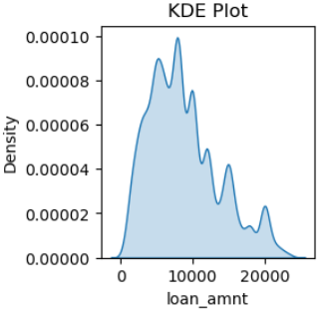
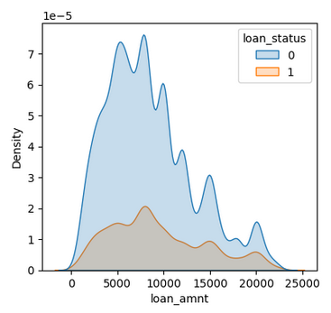
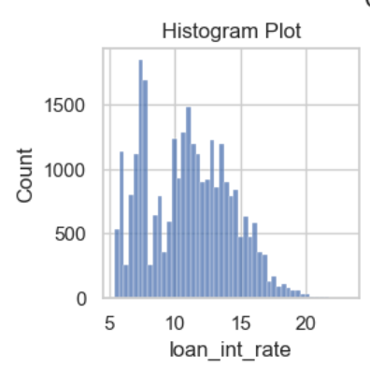
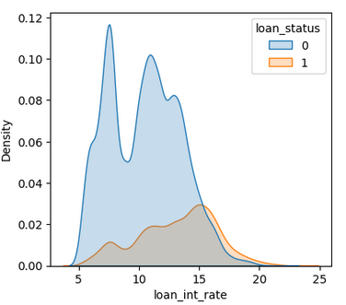
Data Distribution and Patterns
Loan Interest rate ranges from 5.42% to 23.2%.
Almost 96% of population falls under the DTI below 40% among which 30% falls b/w 20 -40% which is a good criteria for loan approval
Loan amount distribution is asymmetrical and skewed.

Slide 6
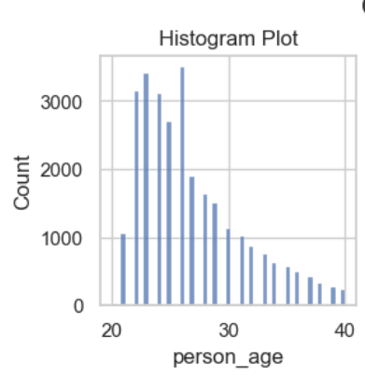
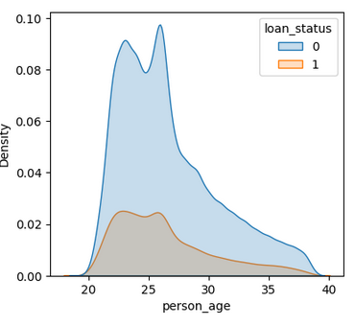
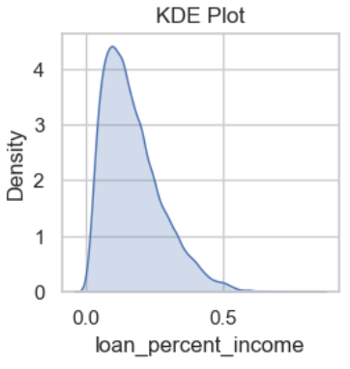
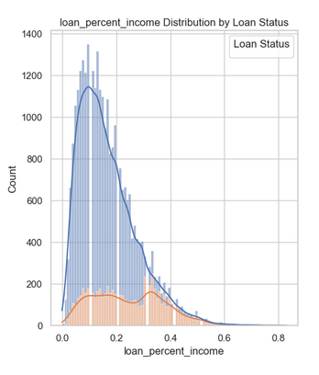
Person Age ranges from 20 to 144 and Mean age of 27.74 indicates data is highly right skewed. skew = 2.58.
Loan – Income percentage distribution is asymmetrical and skewed.

Slide 7
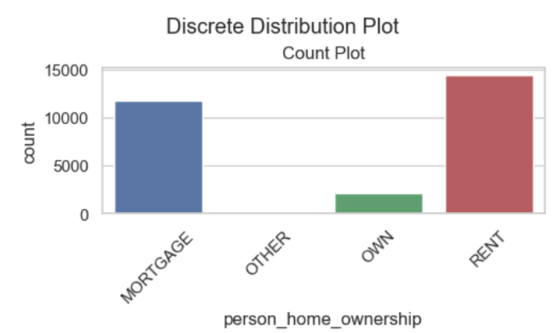
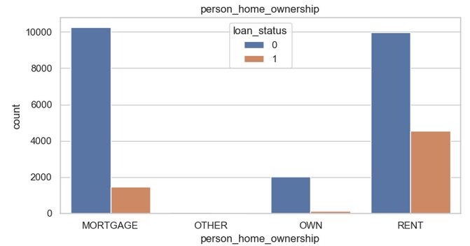
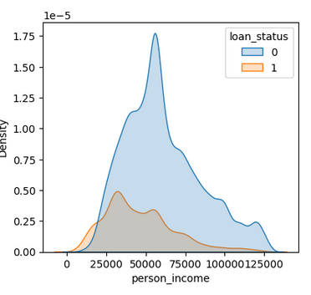
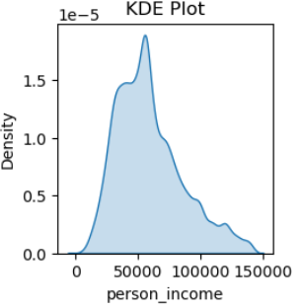
Home ownership is categorical column with 4 different categories where ‘others’ column can be neglected.
Person- Income ranges from 4000 to 6000000 where most of the population are below 2000000/- beyond that seems to be outliers from the distribution plots.

Slide 8
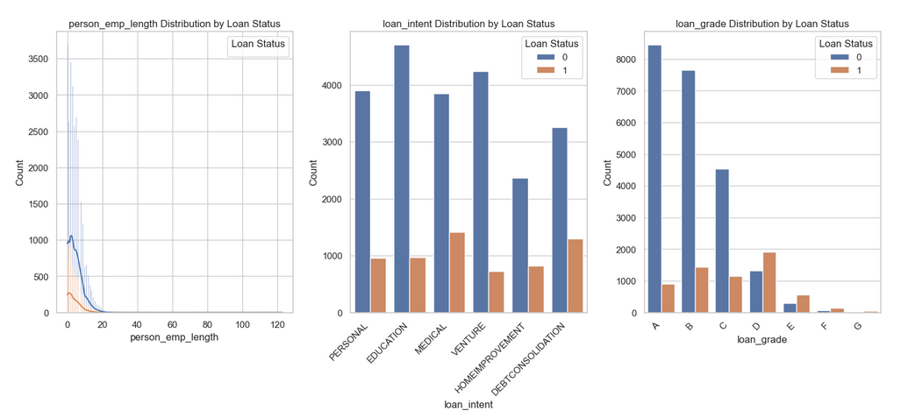
Other Parameters
Loan Grade has no particular information , from the observations Higher the letter denoting the loan_grade, higher is the chance of getting default
More is the employment length , Higher is the chance for loan approval.
More defaulters are there in medical and debt consolidation category

Slide 9
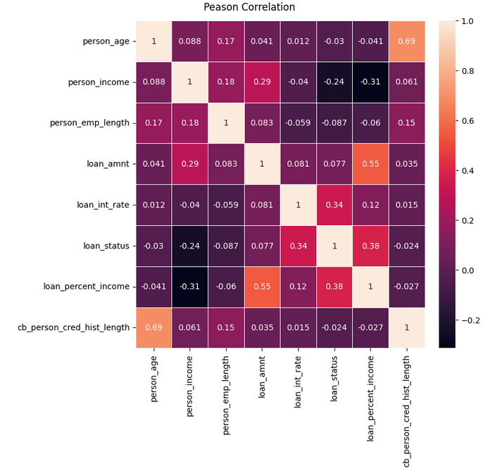
Inferences and Insights:
Most of the plots are asymmetric and right skewed even after removal of outliers.
Percentage of Income is the most influential parameter for the target variable(Debt to income ratio(DTI) in banking terms) Good DTI - below 20%
Person’s Credit History length variable is positively correlated with Target Variable.
Loan Interest rate is the next influential factor that effects loan status
Highest correlated factors: Age & Credit History length — 0.86

Slide 10
References
https://www.analyticsvidhya.com/blog/2022/03/exploratory-data-analysis-eda-credit-card-fraud-detection-case-study/
https://www.researchgate.net/publication/371460741_Credit_risk_analysis_using_boosting_methods

